Slide 1
Alzheimer’s prediction using Ensemble methods

Slide 2


Our Team
Niranjan Reddy Vangala
700730847
Panindra Kumar Gadila
700742480
Nemitha Ravula
700741516
Sai Prakash Reddy Andem
700733549

Slide 3
Roles and responsibilities
3.
1.
2.
3.
4.
1.
Project planning
Requirement analysis
Data collection and cleaning
Exploratory data analysis
Ensemble modeling
Performance evaluation
Documenting the project
Summarizing the results
Web application
Video recording of the project
Uploading the project into Github
Documenting final report

Slide 4
Motivation
Medical industry is the one of the field that leverages the innovations and researches in the respective fields. Since this field demands the continuous gain of knowledge that keeps them updated. Medical field uses different technologies for different kind of problems. Machine learning is the new oil in the medical industry for finding the patterns analysing multiple factors. Medical industry is creating so much data which is impossible to analyze with manual efforts and draw conclusions
Initial stage disease development is symptoms of the disease. We can easily identify the disease if it has the strong symptoms without any medical intervention. Few diseases does not show symptoms directly and those can be analysed from clinical parameters one of them is Alzheimer’s.
Machine learning helps the physicians in analysis of the disease and predictions. In the most recent research it is proved that machine learning algorithms even can predict the pandemics.

Slide 5
Related work
Alzheimer’s is a progressive neuro disorder. Major challenges for diagnosing the disease are that It is difficult to find the symptoms in early stages.These symptoms are similar to other neuro disorder diseases[3].
It is important to create a system to predict the disease without opting MRI method which is an expensive method.The alternative method is to predict the disease with clinical parameters. Traditional algorithms compute the predictions based on the only one method.
Ensemble methods calculate the predictions by introducing diversity means taking the majority voting aggregating the results and adding the feature importance sequentially and removing the unnecessary features in the sequential order.With this diversity performance of the model improves by many folds[1].
The optimal parameters of the algorithms are tuned using GridSearchCV method this method gives the best parameters with respective accuracy of the models to choose[2].

Slide 6
Problem statement
There are multiple factors that affect the person who is diagnosed with the disease Alzheimer’s so scientists research is still at the beginning stages to understand the exact cause of the disease. Main warning signs of this disease is loss of memory and other cognitive impairments.
Brain MRI can detect mild cognitive impairments which can potentially develop Alzheimer’s disease.In the laboratory radiologists analyze these high resolution MRI images for abnormalities however, this process is cumbersome and time consuming most importantly it is prone to human error.
As per a recent survey 5-10% of biomedical images are overlooked by the pathologists.
Developing an alternative method which can be solved using clinical parameters can be useful for repeated visits

Slide 7
Proposed solution
Machine learning methods in the medical industry made a huge impact to reduce human effort and at the same time with accurate results.
Predicting the diseases from the clinical parameters is easy but the size of the data is dependent on the number of volunteers. Generally, the size of the datasets are small and not diverse in nature. Machine learning predictions are efficient when the available data is high or large. However we can use ensemble methods to make the predictions efficient even the size of the data is low.
The key benefit of using ensemble methods are these techniques improve the average prediction of each member
This technique uses statistical methods to measure the prediction power of the each member thereby it introduces the diversity and picks the best predictions

Slide 8
Objectives
In our project we have used a longitudinal dataset i.e. clinical and sociodemographic parameters for training the model. Since the dataset is limited and small, ensemble models are efficient methods to predict the results.
The objective of our project is to predict Alzheimer's disease using three types of ensemble classifiers bagging, boosting and voting
Comparing the results
Selecting the best algorithms and implementing them in the web application.

Slide 9
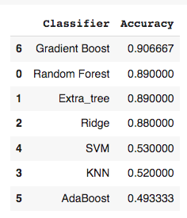
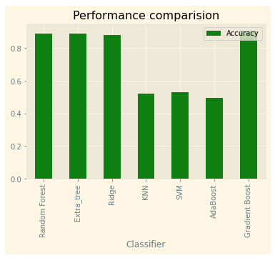
Results
Random Forest, SVM, Gradient Boosting, Extra tree, Ridge, SVM, KNN and AdaBoost classifiers are implemented for multi classification of the disease.
Amongst these Random Forest, extra tree, ridge and Gradient boosting algorithms performed well.

Slide 10
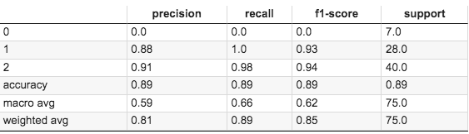
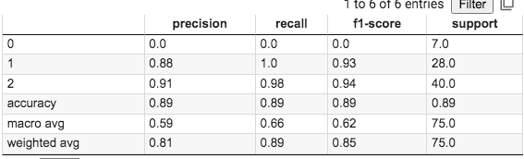
Results
For further analysis of the working and performance of the algorithms classification report and confusion matrix are constructed for best performing algorithms Gradient Boosting and Random Forest.
Classification report of Gradient Boosting
Classification report of RandomForest
Classification report gives a big picture of performance metrics other than the accuracy.Other than accuracy parameter precision, recall and F1 score are displayed in the classification report.
From the above reports we can observe category ‘0’ has the lowest precision, recall and F1 score. Category 2 has the highest precision, F1 score compared to category 1 and category 2 has recall compared to category 1 in Gradient Boosting and Random Forest.

Slide 11
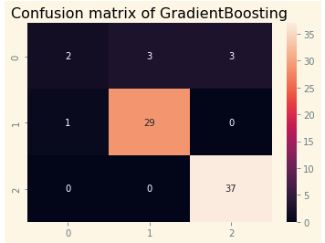
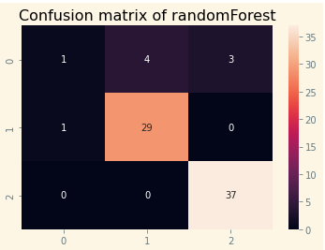
Results
For further analysis of the working and performance of the algorithms classification report and confusion matrix are constructed for best performing algorithms.
Confusion matrix gives the samples of number of misclassification for each category.
Correct classification samples are 68 out of 75 total samples in Gradient Boosting algorithm
Correct classification samples are 67 out of 75 total samples in Random Forest algorithm

Slide 12
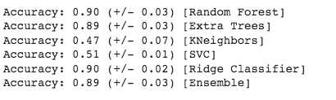
Results
Type of voting method is hard
Amongst all Ridge classifier and Random Forest has the highest score
Accuracies of voting classifiers
In addition to voting ang Boosting bagging classifiers also implemented. In bagging category Extra tree and ridge classifier performed well with 89% accuracy.

Slide 13
References
[1].R. Wang, H. Li, R. Lan, S. Luo and X. Luo, "Hierarchical Ensemble Learning for Alzheimer's Disease Classification," 2018 7th International Conference on Digital Home (ICDH), 2018, pp. 224-229, doi: 10.1109/ICDH.2018.00047.
[2].C. D. Anisha and N. Arulanand, "Early Prediction of Parkinson's Disease (PD) Using Ensemble Classifiers," 2020 International Conference on Innovative Trends in Information Technology (ICITIIT), 2020, pp. 1-6, doi: 10.1109/ICITIIT49094.2020.9071562.
[3].D. Chen, L. Zhang and C. Ma, "A Multimodal Diagnosis Predictive Model of Alzheimer’s Disease with Few-shot Learning," 2020 International Conference on Public Health and Data Science (ICPHDS), 2020, pp. 273-277, doi: 10.1109/ICPHDS51617.2020.00060.

Slide 14
Thank you

